Slide 1
ICS 490: Special topics in Computer Science, Social Media and Text Analysis
Team Members:
Ibrahim BinAlshikh
Ibrahim Beladi
Mohammed Alfarraj
Omar Al-Dakhil

Slide 2
Outline
The Team Members' Contributions in the Project
Introduction to the Problem
Review of some existing work done in this problem
Problem Statement
Project Methodology
Data Collection
Data Description
Data Labeling
Machine Learning Solution
Algorithms' Description
Performance Measures Used
Experiment Design and Setup
Exploratory Data Analysis
Experiment Setup
Performance results
Conclusions and Future Work

Slide 3
Introduction to The Problem
Recently, Saudi Government allowed Cinema in KSA and there were many differing opinions on twitter.
Cinema in KSA or #السينما_في_السعودية contains many tweets between supporters and opponents and neutral

Slide 4
Review of Work Done in The problem
Twitter APIs
Sander’s Lab
Scikit
NumPy

Slide 5
Problem Statement
Many differing opinions on social media especially on Twitter.
Huge data on one single Hashtag.
Trending Hashtags.

Slide 6
Project Methodology
Data Collection
Data Description
Data Labeling
Machine Learning Solution
Algorithm Description
Performance Measures Used

Slide 7
Data Collection
Sander’s Lab
Twitter’s APIs

Slide 8
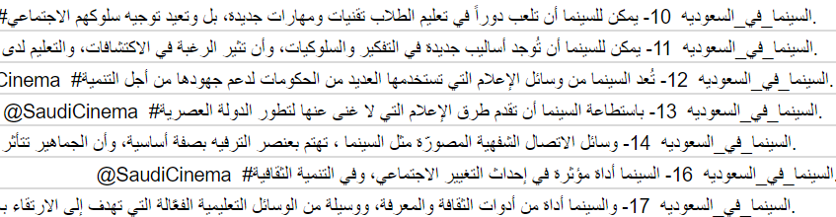
Data Description
Tweets containing the hashtag
#السينما_في_السعودية

Slide 9
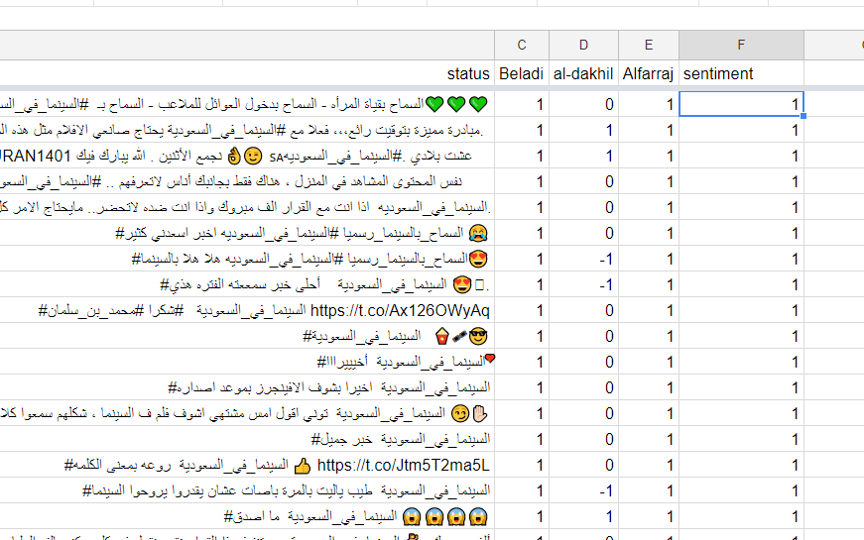
Data Labeling

Slide 10
Machine Learning Solution
Algorithm Description:
Support vector machines.
Random forests.
Multinomial Naïve Bayes.
Logistic Regression Classifier

Slide 11
Machine Learning Solution
Performance Measures Used:
Accuracy
Support vector machines.
Random forests.
Multinomial Naïve Bayes.
Logistic Regression Classifier

Slide 12
Experiment Design and Setup
Exploratory Data Analysis (Data Statistical Analysis)
Experiment Setup
Performance results (using performance measures + graphs + summary tables)

Slide 13
Exploratory Data Analysis
Number of gathered tweets including retweets: 19K+
of which; real Tweets: 2327 tweets
+ 3001 of tweets are gift from Mustafa’s group
Total dataset:5328 tweets
Positive tweets : 1458 tweets
Neutral tweets: 3244 tweets
Negative tweets: 626 tweets
Important words:
166 words gathered after running a frequency term code on the dataset.

Slide 14
Experiment Setup
Tweets collections
Tweets Labeling
Getting Important Words
Feature Extraction
Classification

Slide 15
Performance results
Accuracy | Sander’s Lab | Twitter
Support vector machines | 80.87% | 63.87%
Random forests | 98.04% | 80.8%
Multinomial Naïve Bayes | 77.93% | 66.82%
Logistic Regression Classifier | 78.5% | 68%

Slide 16
Conclusions and Future Work
There is no best algorithm for all datasets.
Random Forest got the best result for our dataset.
+5000 Tweets are not enough dataset for most of the algorithms to work with high accuracy.
It’s so difficult to get the most important words “Features”, because of the small difference in arabic spelling.
Data labeling is time consuming.
Having too many neutral tweets can hurt the algorithms accuracy.

Slide 17
Team members’ contributions in the project
Ibrahim BinAlshikh: Ass#3 + Presentation Outline
Ibrahim Beladi: Data collection, Data labeling, Processing Data, Machine learning algorithms.
Mohammed Alfarraj: Data collection, Data labeling, Processing Data, Getting Most Important Words, Machine learning algorithms.
Omar Al-Dakhil: Data labeling, Machine learning algorithms, Presentation

